Slide 1
Improve UnitTests for Temporal Memory Algorithm
Group name:Variable-I
Group members:
Syed Mostain Ahmed (1390214)
Farjana Akter (1344037)
Md. Shamsir Doha (1344011)

Slide 2
Agenda
Introduction
Goals of your project
Implementation
Result
conclusion

Slide 3
Introduction
Temporal memory algorithms have gained popularity as a promising approach for modeling temporal sequences in machine learning. This project aims to improve the unit test for the given temporal memory algorithm, which is based on the principles of the cortical column and the neocortex. The algorithm uses a sparse distributed representation of data and incorporates temporal context to predict future values in a sequence. We implemented improvements to the existing unit test, including the addition of more test cases with varying complexity and the implementation of cross-validation techniques for better evaluation of the algorithm's performance. We also optimized the implementation of the algorithm for improved efficiency and scalability.

Slide 4
Goals of your project
Improve UnitTests for Temporal Memory Algorithm
Create some unique test case
Create test case using dataset.

Slide 5
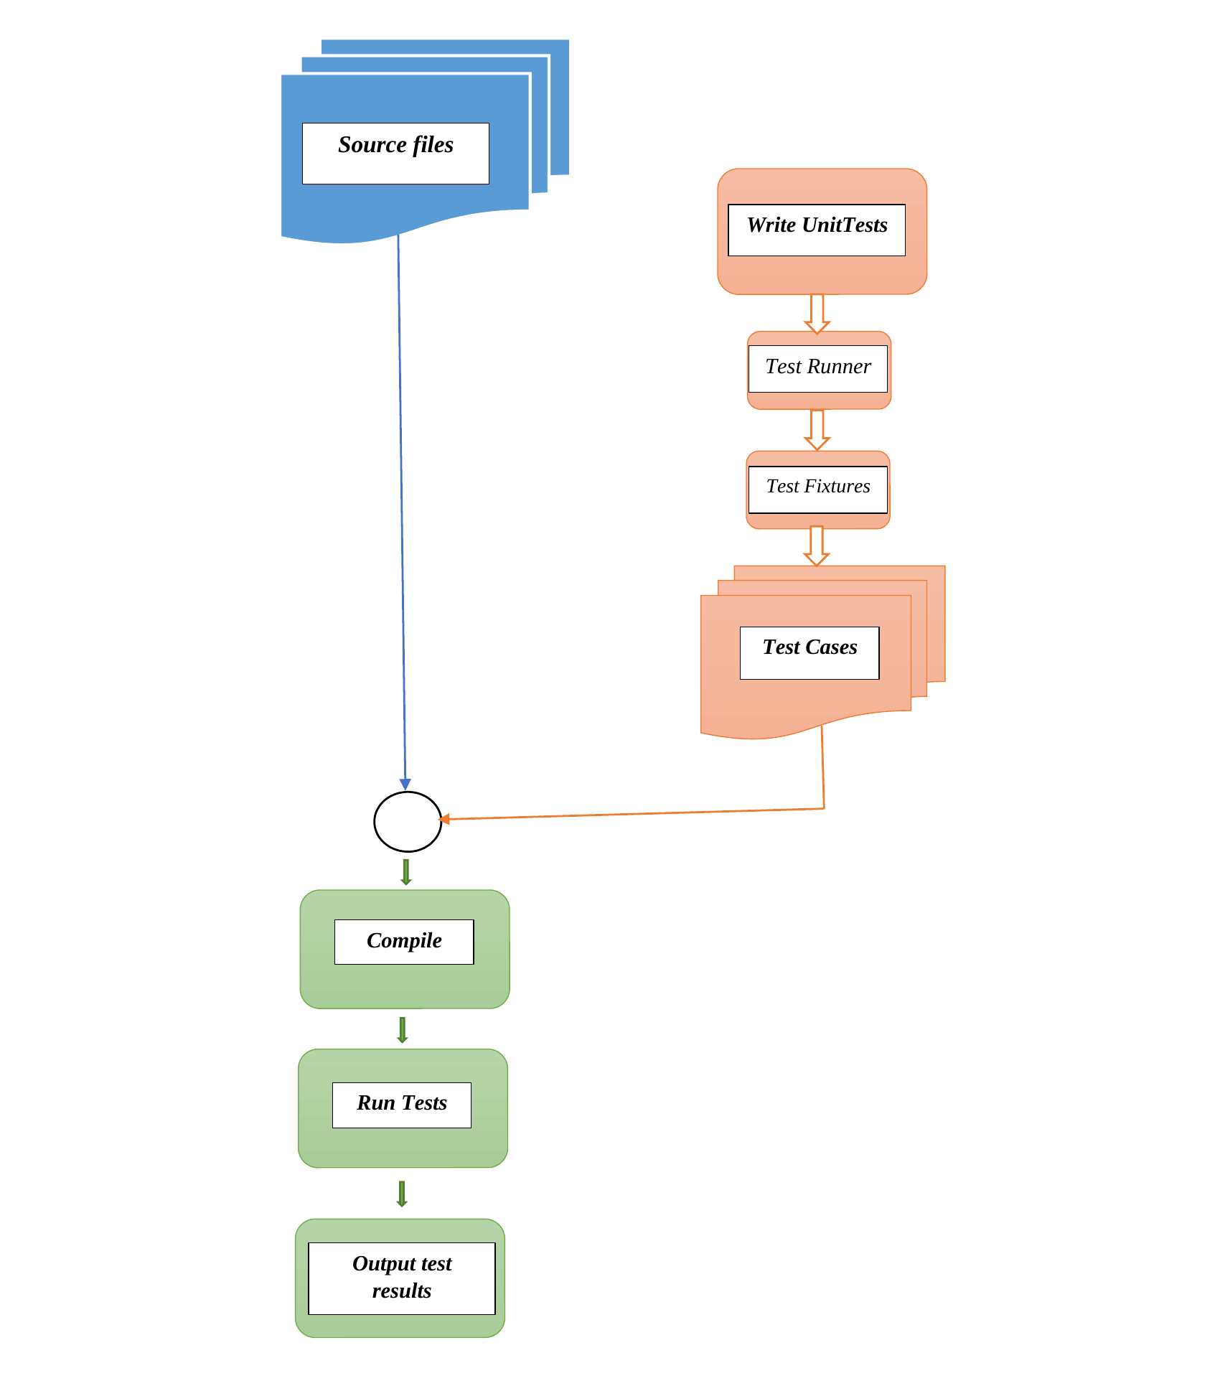
Implementation

Slide 6
Implementation

Slide 7
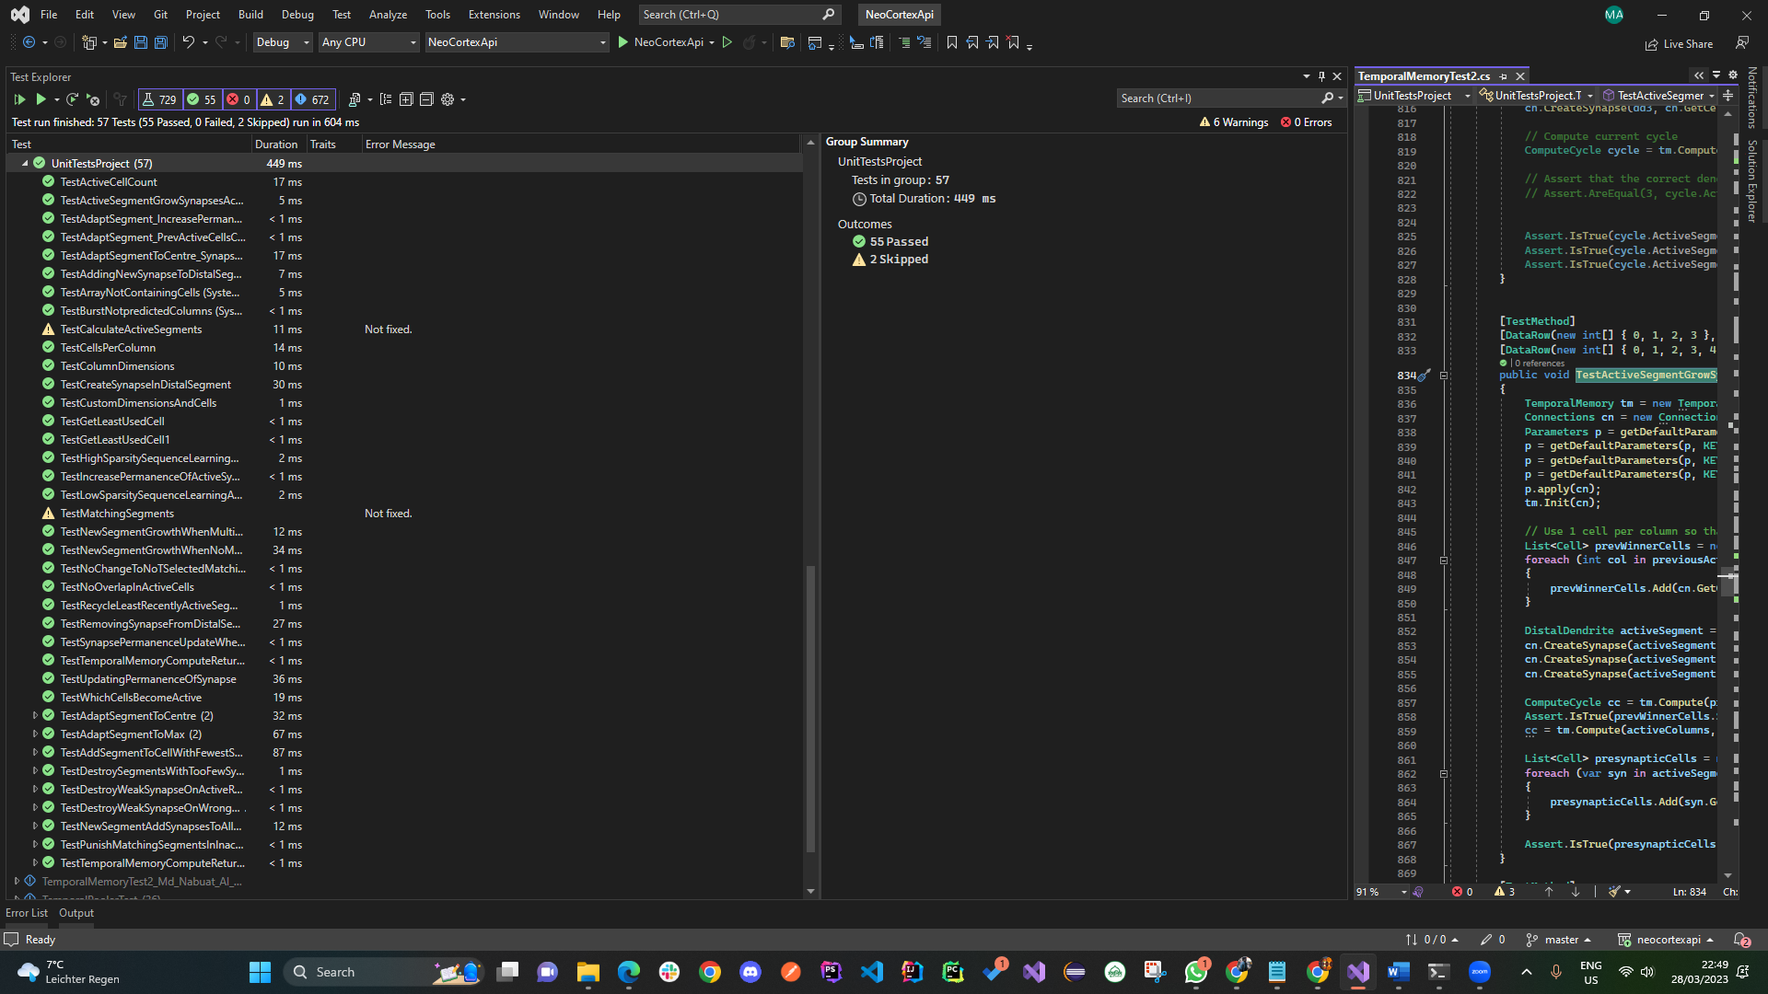
Result

Slide 8
Conclusion
“
”

Slide 9
Thank you

